Slide 1
Bootstrap e-Portfolio
Jakob Stegmüller

Slide 2
Structure
General
Installation
Layout
Components
Utilities
Live Programming

Slide 3
general
Frontend Framework
CSS
JavaScript

Slide 4
general
Pro
Con
Speeds up development
Responsive
Grid system
Large amount of components
JavaScript functionality
Well documented and supported
Design
Non supported HTML attributes

Slide 5
installation
Download from “getbootstrap.com”
Bootstrap.min.css
Bootstrap.min.js
Include as stylesheet and script in website

Slide 6
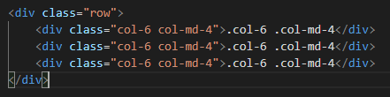
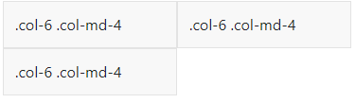
Layout / Grid System

Slide 7
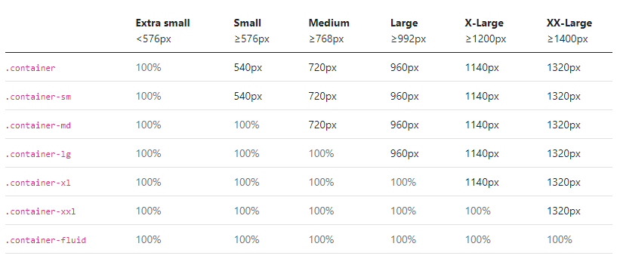
Layout / Container

Slide 8
Components / Buttons

Slide 9
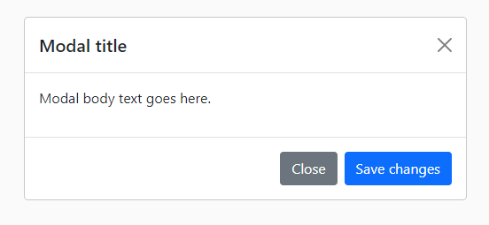
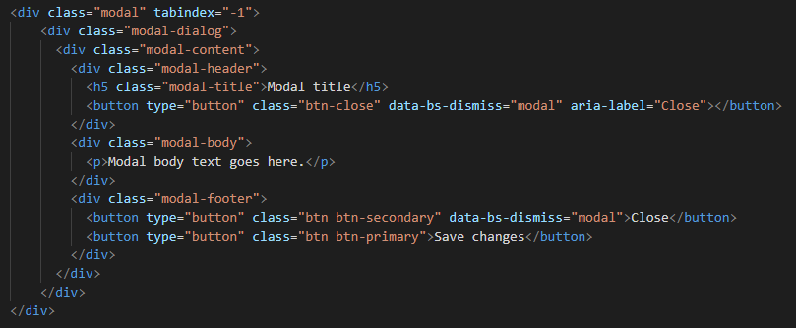
Components / Modals

Slide 10

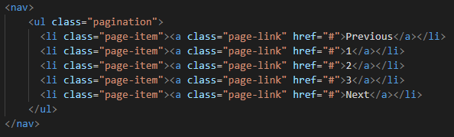


Components / pagination

Slide 11
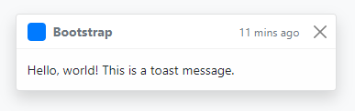
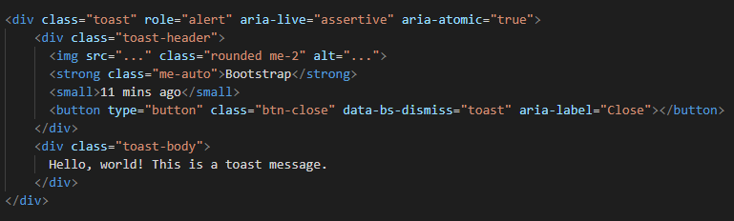
Components / toasts

Slide 12
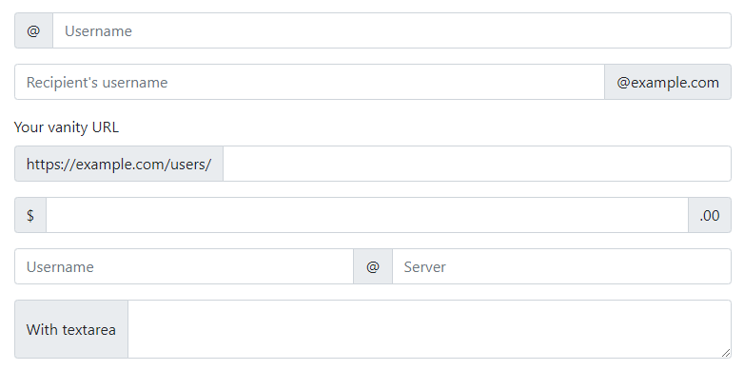
Components / Input groups

Slide 13
utilities
Class based utility
All CSS attributes supported
Good for prototyping
Different design and visibility on certain viewport sizes
Intuitive Naming schema

Slide 14
Utilities / Spacing
Keyword | direction | amount
m : margin | t : top | 1
p : padding | b : bottom | 2
 | s : start | 3
 | e : end | 4
 | x : left and right | 5
 | y : top and bottom | 6
 | blank : all directions | auto

Slide 15
Live Programming

